Slide 1
Chemistry – Nov 25, 2019
P3 Challenge-
  Pick up a periodic table handout or get yours out
  Copy a square of your choice from the periodic table.
  Identify what type of information is included.
    “At the top is… In the middle is... and … At the bottom is…”
Today’s Objective –
  The Periodic Table
Get out the Nuclear Chemistry Problems for HMK Check

Slide 2
Chemistry – Nov 13, 2018
Agenda –
  Periodic table history
  Organization of periodic table
  Periodic properties
  Metals/nonmetals
  More about elements
Assignment: -
  Element Wanted Poster

Slide 3
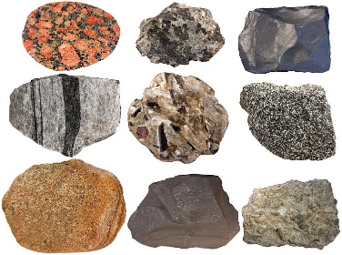
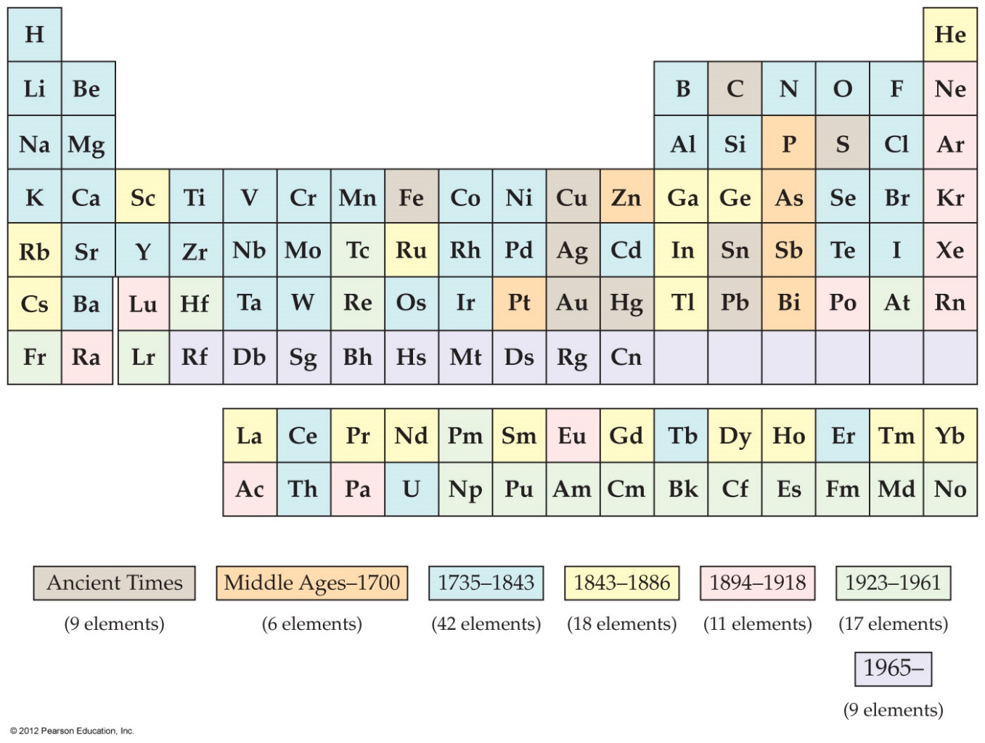


Ancient Times
Aristotle
Naturally occurring minerals
9 elements

Slide 4
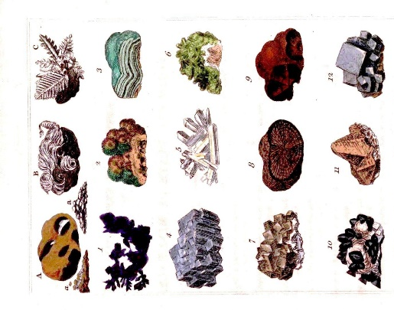
Middle Ages
Alchemy
Macroscopic observations only
No scientific method
Prevailing world view: this world doesn’t matter, only the next
15 elements

Slide 5
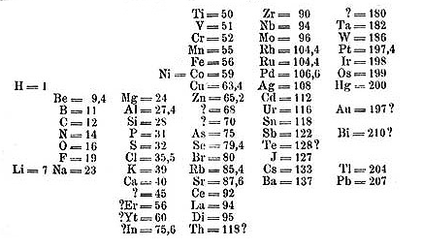
1735 – 1864
Antoine
Lavoisier
(1789)
-Wrote the first list of elements (19)
Stanislao Cannizzaro (1860)
-Developed a way to accurately measure atomic mass
John Newlands (1864)
-Observed periodic law (octaves)
Renaissance
Scientific method applied
Preliminary laws
Atomic theory (1805)
Well known elements for Mendeleev
57 elements
Notes:
Laoisier’s list included oxygen, nitrogen, hydrogen, sulfur, phosphorus, carbon, antimony, cobalt, copper, gold, iron, manganese, molybdenum, nickel, platinum, silver, tin, tungsten, and zinc.

Slide 6
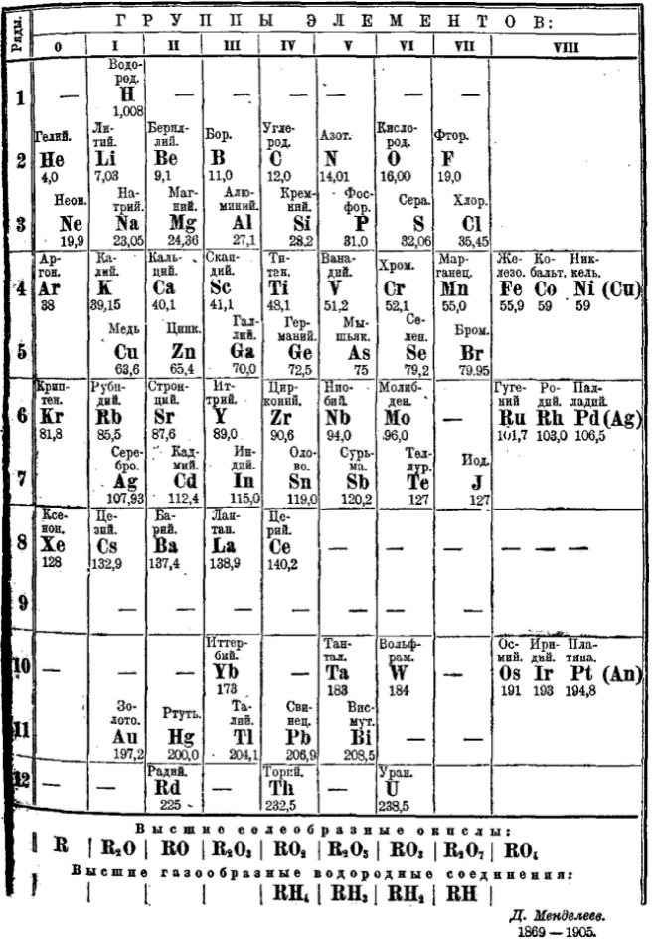
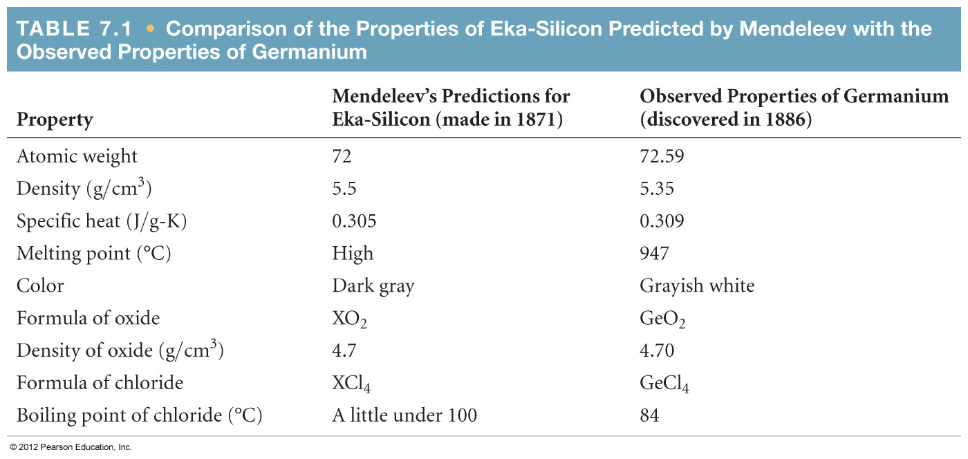
Development of Periodic Table
Dimitri Mendeleev (1869)
  Created the first periodic table ranking elements based on their atomic mass and periodic law (also Lothar Meyer for this part)
  Predicted the discovery of germanium (which he called eka-silicon) as an element with an atomic weight between that of zinc and arsenic, but with chemical properties similar to those of silicon.

Slide 7

1870 – 1886
Mendelev’s Table used.
Some conflicts between increasing atomic mass and periodic law appear.
Functional periodic table
Atomic theory prevails
A lot done by Germans
Organic chemicals discovered (vitalism discounted)
75 elements

Slide 8
1894 – 1918
Sir William Ramsay (1904)
- Discovered the noble gases
Henry Moseley
(1913)
-Fixed the ordering to base it on atomic number (#p)
Neon lights
Line spectra
Bohr model then Quantum Mechanics
Radioactivity studied.
86 elements
Nearly all of the naturally occurring (92) found

Slide 9
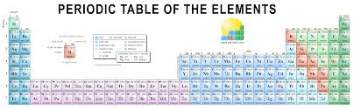
Organic chemistry and Biochemistry expand extensively
Quantum Mechanics
Nuclear chemistry discovered
New materials research – plastic is born
103 elements
New elements are synthetic
1923 – 1961
Glenn Seaborg
(1951)
- Discovered 10 elements the actinides (f block elements)

Slide 10
New elements discovered only by particle physicists
New materials research – ceramics and superconductivity
Biochemistry becomes the leading edge
118 elements
with 98 naturally occuring.
1965 - present
Nh
Fl
Mc
Lv
Ts
Og

Slide 11
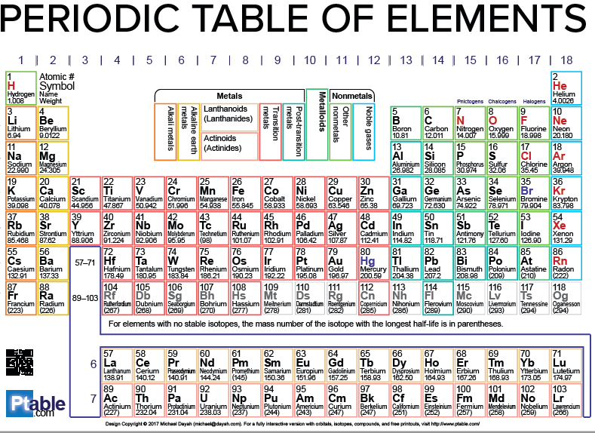
Periods
  1-7 Rows
Groups
  Columns
  1-18
  1-8 A / B
  A = main group elements
Alkali metals
Alkaline earth metals
Transition metals
Other metals
Semimetals
Halogens
Noble gases
Other Nonmetals
Lanthanides
Actinides
Division line
1A
2A
3A
4A
5A
6A
7A
8A
1
2
3
3B
4B
5B
6B
7B
8B
8B
8B
1B
2B
4
5
6
7

Slide 12
Elements within a Group share Chemistry – Periodic Law
Alkali metals (Group 1) are soft enough to cut with a butter knife, react with water, form strong bases
Alkaline earth metals (Group 2) are similar to alkali but less reactive with water and harder. They also form strong bases.
The halogens (Group 17) form diatomic molecules and vary in states down the group from gases to solids. They are nonmetals and react with metals to form salts. They react with water to form acids.
The noble gases (Group 18) are unreactive and exist as gases.

Slide 13
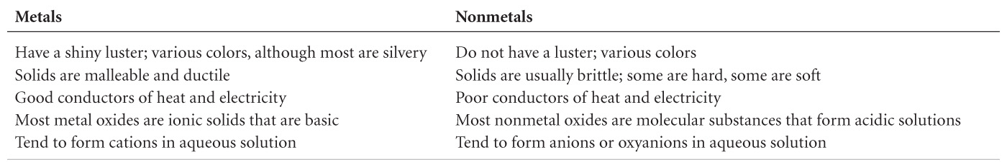
Metals / Nonmetals / Metalloids
Differences between metals and nonmetals tend to revolve around these properties.
Metalloids have some properties from both lists.

Slide 14
States of the elements
Everything on this slide is a memory item.
Most elements are solids.
There are two liquids: Br₂ and Hg
There are 11 gases: H₂, N₂, O₂, F₂, Cl₂ , He, Ne, Ar, Kr, Xe, Rn
There are 9 molecular elements H₂, N₂, O₂, F₂, Cl₂ , Br₂, I₂, S₈, P₄
All others exist as individual atoms.

Slide 15
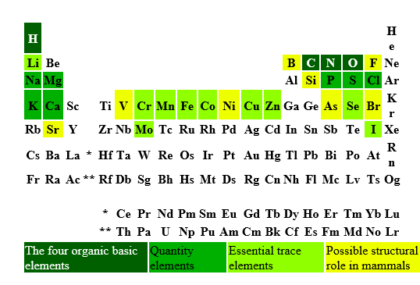
Distribution of elements
98 naturally occurring elements (1 – 98)
  6 discovered naturally only in small amount added recently, so most people say 92 or 91 (because of Tc)
60 elements used in the human body
  6 most common make up 99%: O (65%), C(18%), H(10%), N, Ca, P
  5 significant ones make up 0.85%: K, S, Na, Cl, Mg
  Trace others: Fe, F, Zn, Si, Rb, Sr, Br, Pb, Cu Al, Cd, Ce, Ba, Sn, I, Ti, B, Se, Ni, Cr, Mn, As, Li, Hg, Cs, Mb, Ge, Co, Sb, Ag, Nb, Zr, La, Te, Ga, Y, Bi, Tl, In, Au, Sc, Ta, V, Th, U, Sm, W, Be, Ra
Most abundant in universe: H (74%), He (24%)
Most abundant for earth: Fe (32%), O(30%), Si(15%), Mg(14%), S, Ni, Ca, Al
Most abundant for earth’s crust: O(47%), Si(28%), Al(8%), Fe(5%), Ca, Na, K, Mg
Notes:
The elements found in nature are elements with atomic numbers 1 (hydrogen) through 98 (californium). Ten of these elements occur in trace amounts: technetium (No. 43), promethium (61), astatine (85), francium (87), neptunium (93), plutonium (94), americium (95), curium (96), berkelium (97), and californium (98).

Slide 17
Exit Slip - Homework
Exit Slip:
  Choose your element for your element poster.
What’s Due? (Pending assignments to complete.)
  Wanted: Element Poster (due in one week, on Tuesday 12/3)
What’s Next? (How to prepare for the next day)
  Read Holt p95-98

